Slide 1
Exploring OSS on Azure
Abdul Rasheed Feroz Khan,
Microsoft MVP – Azure.

Slide 2
Agenda
Introduction to Azure
Exploring OSS
Linux on Azure
Kubernetes
Deploying, Scaling, Securing LAMP Application
Hand on Lab

Slide 3
Introduction to Open Source on Azure

Slide 4
Open Source Software on Azure
From Node.js to Ubuntu, bring your favourite open source software tools and technologies to Azure and open up the possibilities.

Slide 5
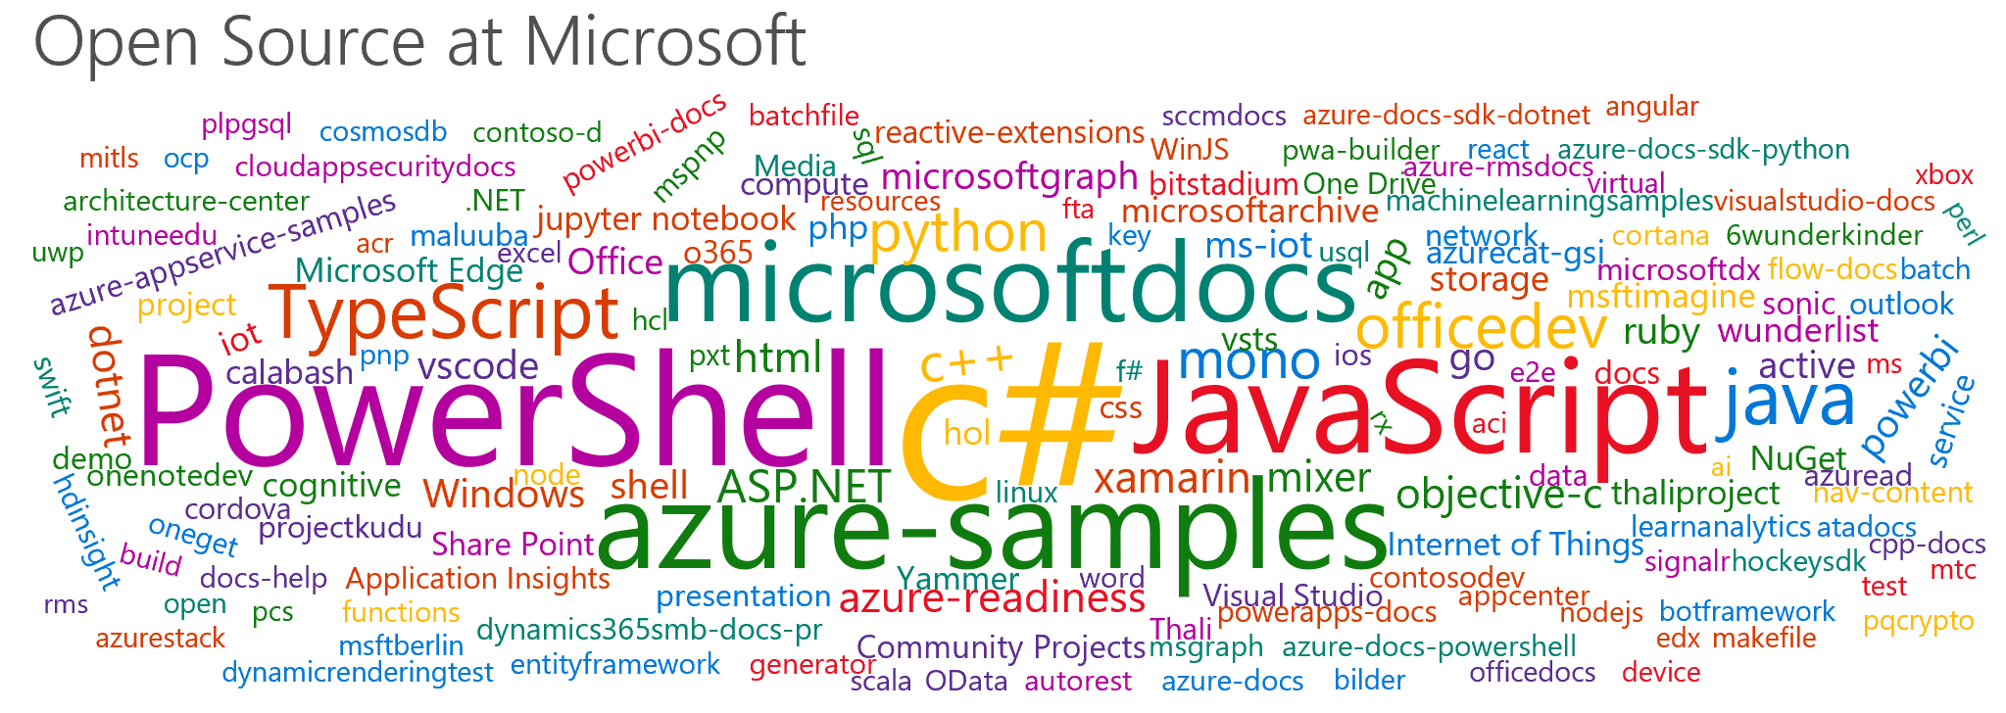

Slide 6
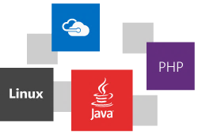

Slide 7
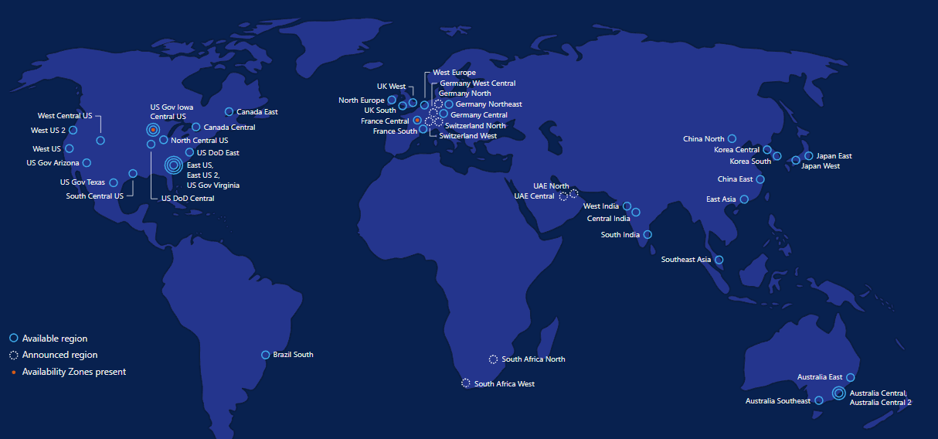
50 Regions

Slide 8





































Slide 9
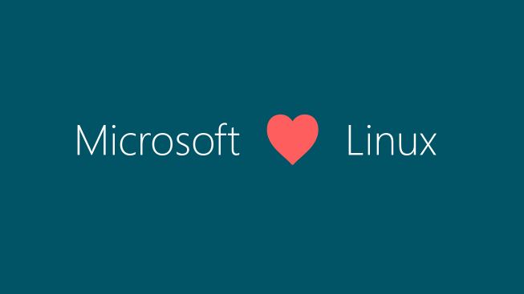

Slide 10
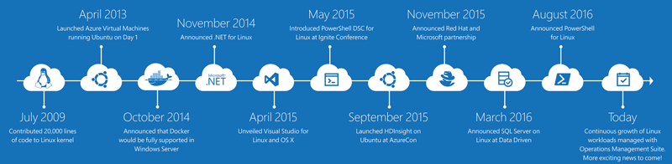
Microsoft & Linux: It’s been a journey

Slide 11
Open Approach For your journey to the cloud
Empowering our Customers
By Enabling Choice
To Provide a Trusted Cloud
Freedom of Choice
Freedom from Choice
Maximize Value
Vibrant Local IT Economy
X-Platform
Open Standards
Interoperability
Open Source Community Engagement
Secure
Private
Transparent
Compliant and Certified

Slide 12
Azure VM
Regions
Availability
Managed Disks
VM Sizes
Automation

Slide 13
Linux Distributions on Azure
CentOS
CoreOS
Debian
Oracle Linux
Red Hat Enterprise Linux
SUSE Linux Enterprise
openSUSE
Ubuntu

Slide 14


LAMP → Azure
Create an Ubuntu VM (the 'L' in the LAMP stack)
Open port 80 for web traffic
Install Apache, MySQL, and PHP
Verify installation and configuration

Slide 15

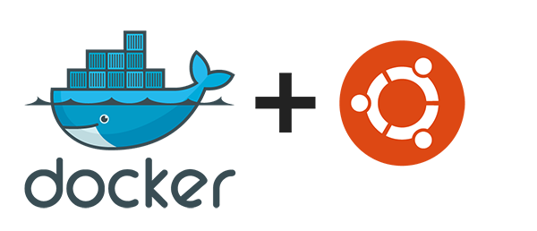
Linux containers
RancherOS
Docker on Ubuntu Server

Slide 16
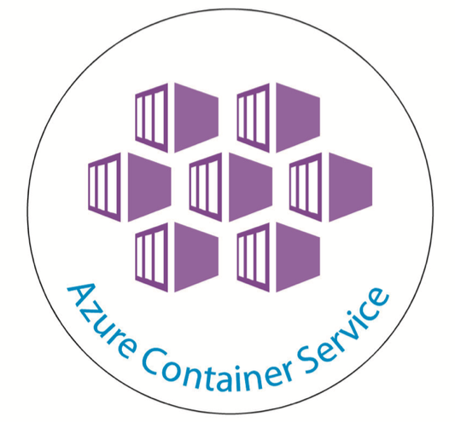
Azure Container Service
Allows you to quickly deploy a production ready Kubernetes, DC/OS, or Docker Swarm cluster

Slide 17

Kubernetes

Slide 18
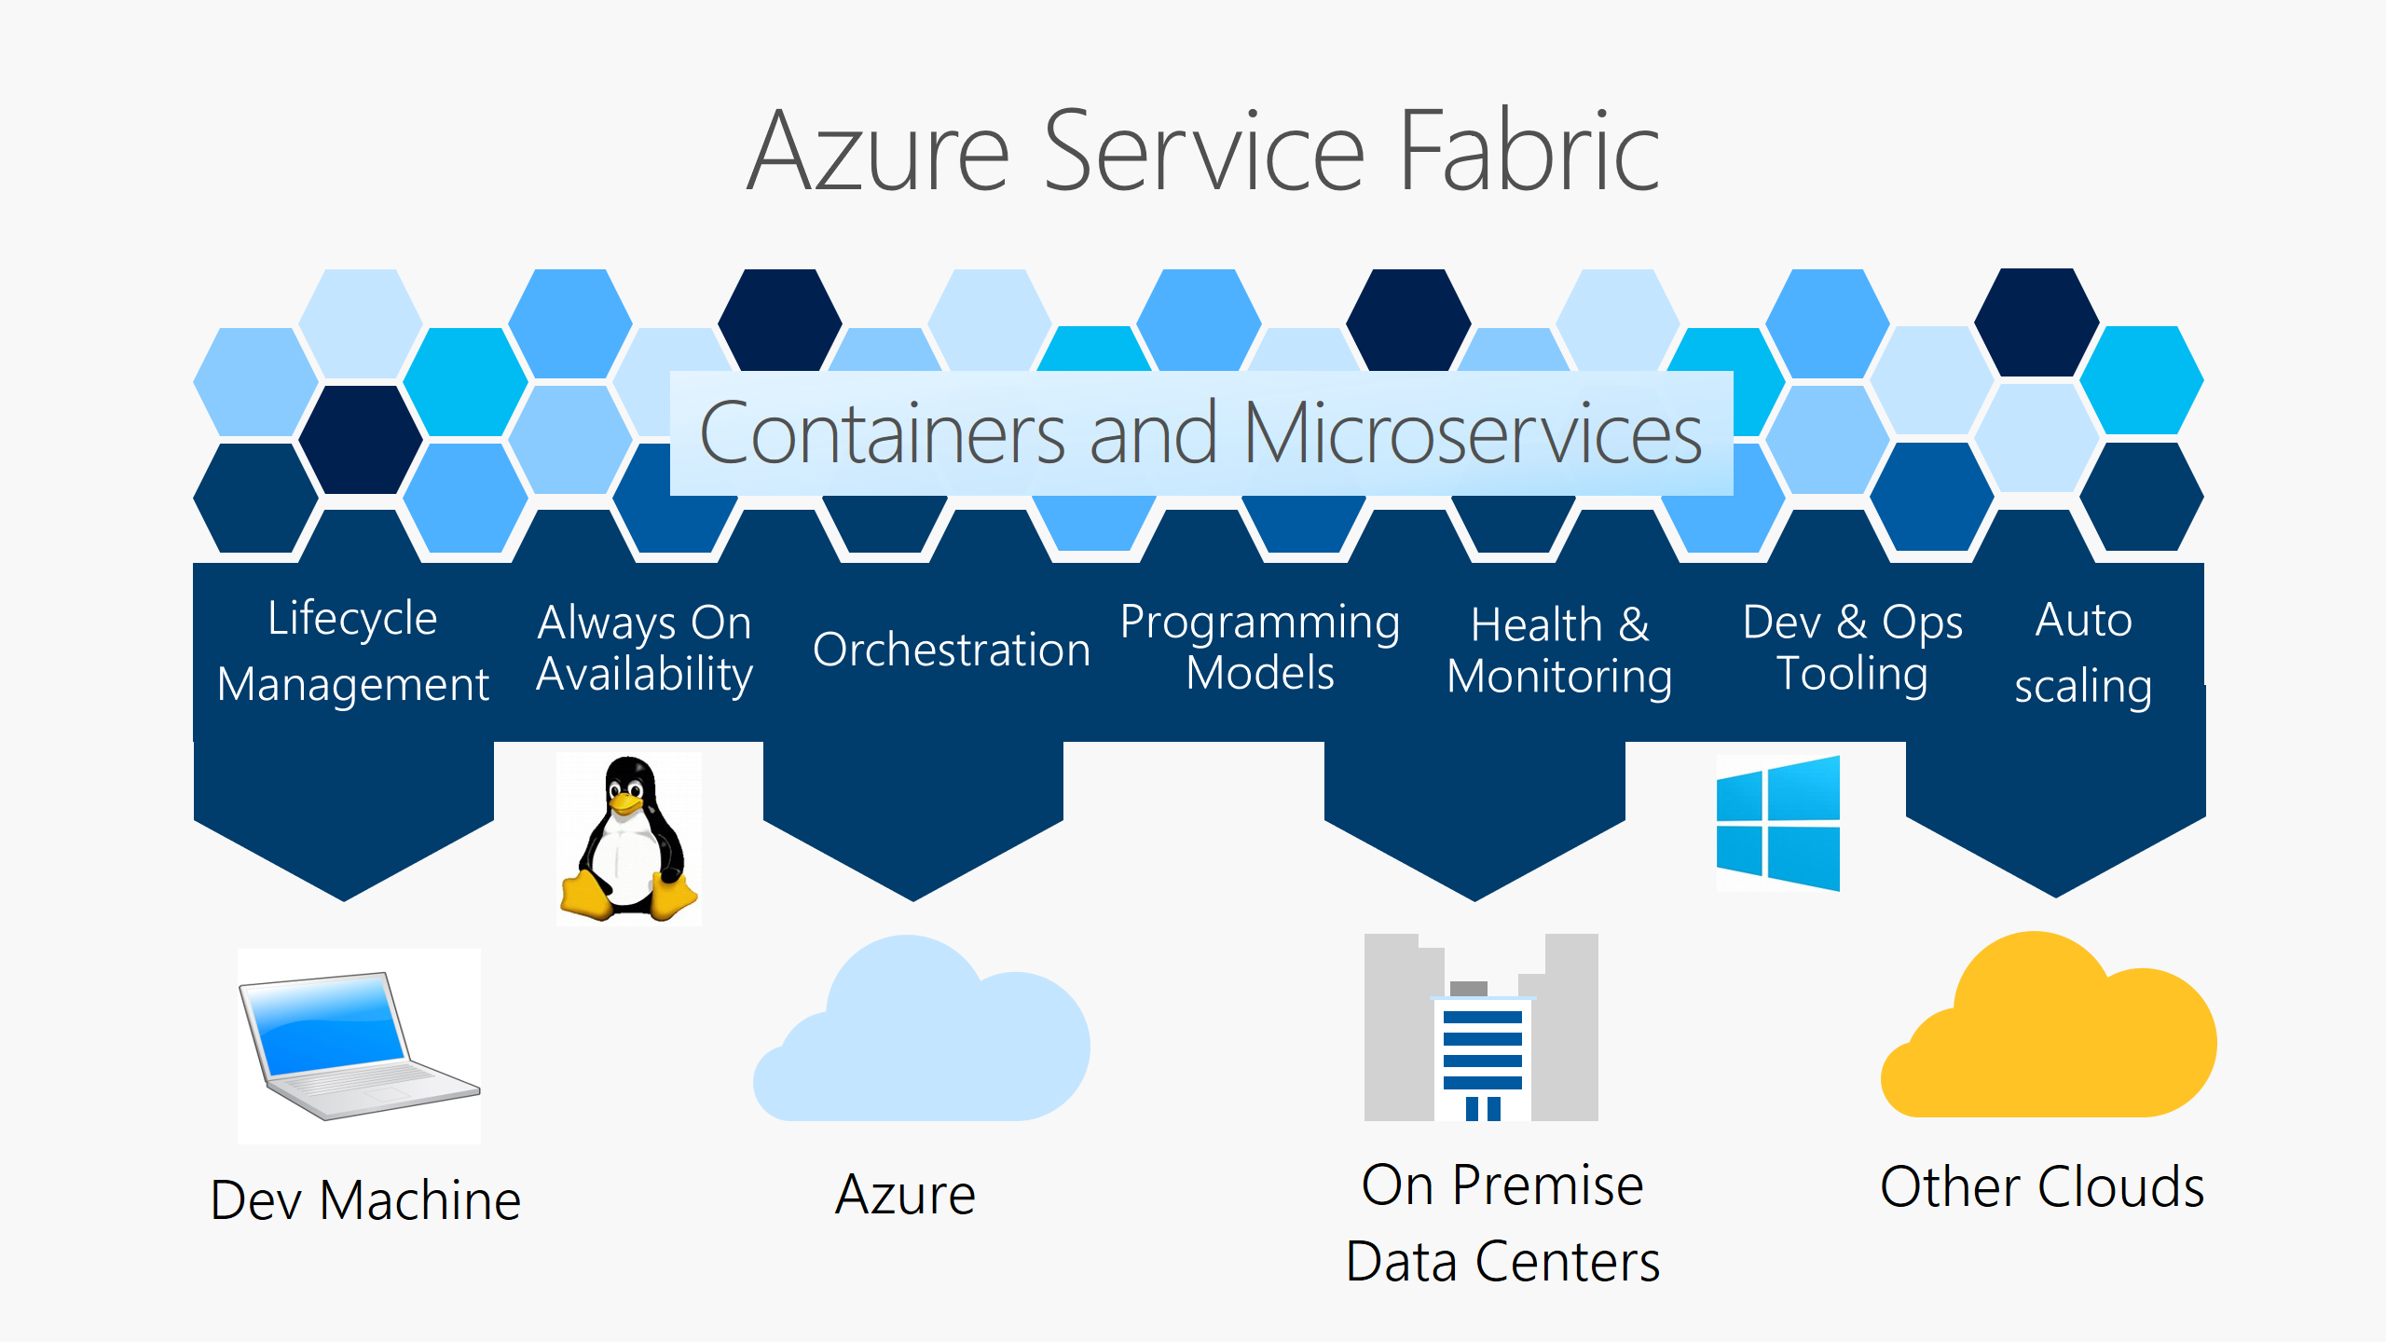
Azure Service Fabric

Slide 19
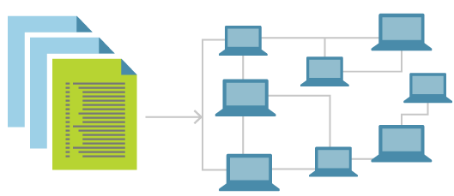
Infrastructure as Code
The process of managing and provisioning computing infrastructure and its configuration through machine-processable definition files

Slide 20

Azure Functions
Serverless compute service that enables you to run code on-demand without having to explicitly provision or manage infrastructure.

Slide 21
Use Cases:
When to use Azure Service Fabric?
When to use K8’s?
When to use Azure Container Services?

Slide 22
Customer Stories
Notes:
Middle one – design ideas

Slide 23

BMW enables driver mobility via Azure Service Fabric

Slide 24
BMW Connected application needed a solution for combining machine learned driver intents, real time telemetry from devices and up-to-date commute conditions such as traffic, monitor the commute needs of each driver

Slide 25
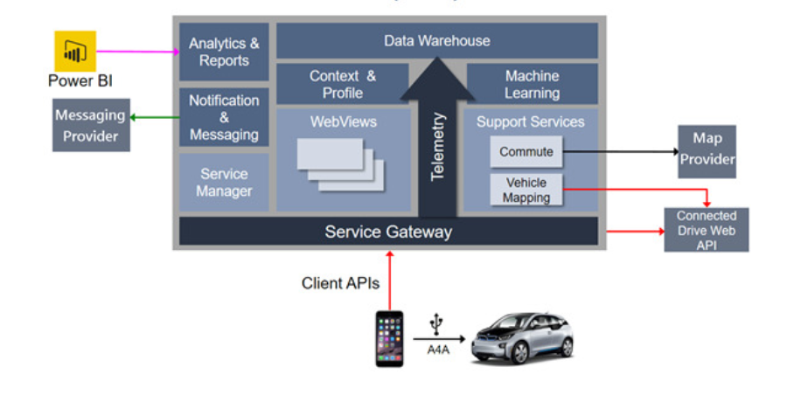
BMW’s Open Mobility Cloud (OMC) Architecture
Notes:
Enabling Driver Mobility via Service Fabric
In order to proactively act on behalf of a user, the BMW Connected application needed a solution for combining machine learned driver intents, real time telemetry from devices and up-to-date commute conditions such as traffic. In addition, this service was built to scale up to millions of drivers, and asynchronously monitor the commute needs of each driver.
Furthermore, BMW wanted to continually update the service with learned behaviors and commute condition resources. Because of these reasons as well as mobile client limitations (battery and background processing) they found that the Service Fabric Actor model was the right solution for their service.

Slide 26
Why Azure Service Fabric
Continually update the service with learned behaviours and commute condition resources
Mobile client limitations like battery and background processing

Slide 27
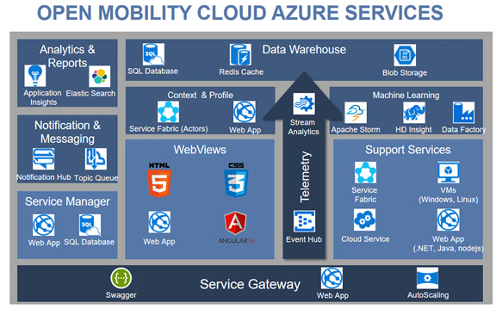
Open Mobility Cloud Azure Services ?
Notes:
Enabling Driver Mobility via Service Fabric
In order to proactively act on behalf of a user, the BMW Connected application needed a solution for combining machine learned driver intents, real time telemetry from devices and up-to-date commute conditions such as traffic. In addition, this service was built to scale up to millions of drivers, and asynchronously monitor the commute needs of each driver.
Furthermore, BMW wanted to continually update the service with learned behaviors and commute condition resources. Because of these reasons as well as mobile client limitations (battery and background processing) they found that the Service Fabric Actor model was the right solution for their service.

Slide 28
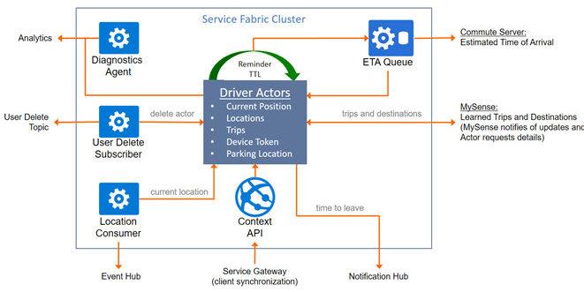
Context & Profile Subsystem

Slide 29
Role of Azure Service Fabric
Scaling millions of drivers made easy
Mobile client limitations like battery and background processing
Rolling upgrades without any downtime
Automatic replication and failover capabilities
Effortlessly roll back to the previous version in case of any error
Company need to focus only the core functionality of their Connected mobile application

Slide 30
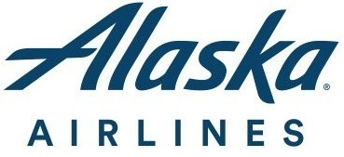
Alaska Airlines improves services in the cloud using containers and Azure Service Fabric

Slide 31
alaskaair.com
The systems supporting the website
enable people to make reservations
look up travel information
manage their mileage plans
get customer support
and more. . . . . . .

Slide 32
Scale and Capacity Issues
Outgrew their datacentre.
Loss of services caused by
Networking issues
Hardware issues
Virtual machine issues
Performance impacts
Governed usage to maintain uptime requirements

Slide 33
From on-premises to Azure
Azure App Service for hosting their ported APIs,
Azure API Management for secured access to those hosted APIS
Azure Cache for session management.

Slide 34
Next Challenge
Design flaw prevented the system from recovering from failures on top of the inconsistent performance of third-party APIs and downstream dependencies
Need of horizontal scale of the whole system beyond the App Service scaling limit

Slide 35
Solution of Alaska
Uphold their use of VSTS for CI/CD.
Work with limited to no refactoring--there wasn't time.
Run locally, on-premises, and in the cloud.
Support a variety of libraries and technology versions.

Slide 36

Azure Service Fabric

Slide 37
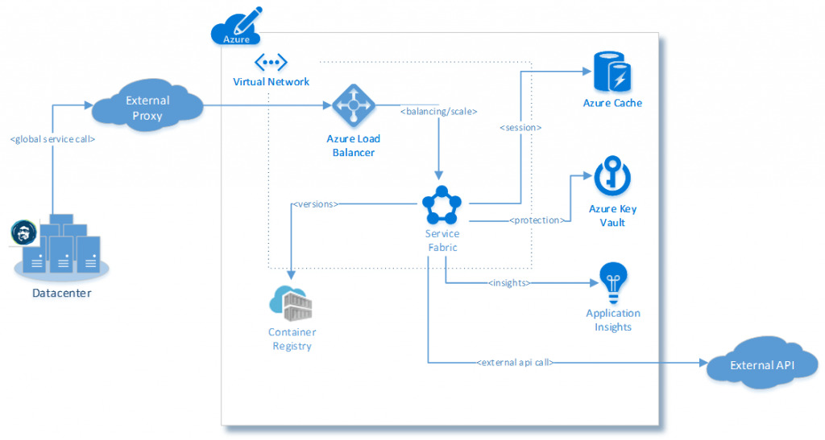
Shopping Cart API architecture
Notes:
The Shopping Cart API wasn't built on the .NET Core, so it wasn't host-independent. The API required Internet Information Services (IIS), which isn't supported as an application host, since Service Fabric expects workloads to be self-hosted.
The solution to this challenge involved yet another technology introduced to the team at the hackathon--Windows Server Containers.

Slide 38
Azure Service Fabric + Windows Containers
Improved scale and density they needed for their crucial service with greater control
Self-correcting when a node or the services on the node fails
API Deploy time and time for consumption reduced
20 minutes in Azure App Service to 10 seconds in service fabric
In-place upgrades with automatic rollback
Savings at scale

Slide 39

“We love the pristine and predictable environments provided by Windows Server Containers. Service Fabric brings us a safe and consistent deployment strategy that maximizes uptime. The marriage of the two in Microsoft Azure gives us unlimited potential” Ralph Feltis: Software Engineer Alaska Airlines

Slide 40
Recall Assessment

